Slide 1
Training plan – January 2019
Jean-Baptist Bultynck – Kader Touati
Alan Brown – Kelesha Antoine - Lingling Zhang - Tracey Lovell

Slide 2
2019 !!!
May every day of the new year glow
with good cheer & happiness
for you & your family!
Happy New Year!
Happy new year * 明けましておめでとう * Bonne année * Gelukkig Nieuwjaar * Feliz Año Nuevo * Frohes neues Jahr * Felice Anno Nuovo * 新年快乐 * Gott Nytt År * An Nou Fericit * Šťastný nový rok * Chúc Mừng Năm Mới * عام جديد سعيد * Selamat Tahun Baru * Ευτυχισμένος ο καινούριος χρόνος * 새해 복 많이 받으세요 * Szczęśliwego nowego roku * नव वर्ष की शुभकामनाएँ * Feliz Ano Novo * godt nytt år * Hyvää uutta vuotta

Slide 3
Objectives & Planning
Healthy, Happy, Sportive and Prosperous New Year!
2018 has been a special year with 2 big tournaments, U17 & U20, in preparation of FWWC France 2019! The open-list had been reduced just before the start of this 2018. Even more focus and pressure on the remaining group. A final selection has been made at the end of 2018. (Don’t forget still an open list …)
Unfortunately not all could be in the final group. For sure a disappointment for each of you not selected. But be proud the way you have grown, the progress in many domains you made, as well the difficulties you made to those who had to choose! Sure the past two years made you another person and a better referee/assistant-referee. Congrats for this! And hope to see you in future times! Sure you will support the selected ladies!
Congratulations for the selected ladies. You made a big step, being selected. On the other hand, it’s only your ‘entry-pass’. We don’t want to see happy ladies to ‘enter’, we want to see top-confident ladies in top-shape with a lot of experience in you back-pack!
Hope you enjoyed 1 or 2 weeks holiday … and let’s start the final preparation towards July 2019! Several seminars have been planned. Most of the referees have the opportunity to use the Statsport unit.
In general the fitness requirements remain the same. So no extra pressure from that side ☺ You proved excellent shape last year, only some personal weaknesses have to be solved ☺ The final target, getting each of you top-fit and healthy at the start of FWWC France 2019! (For those not selected, be ready as well. You never know in live.)
Don’t forget keep informing us adequately!
The focus in January is a combination of endurance ‘build-up’ and preparation for the upcoming FIFA fitness tests in many confederations and member associations. In general the January training should give a good base.
(For the UEFA referees, the preparation makes it still possible to prepare your Winter Course.)

Slide 4
Objectives & Planning
REMINDER:
The training plan has been organized to a typical week that involves only one match on the weekend. If you have another match or mid-week match – please discuss this plan with your local coach and adjust for you needs.
We recommend that all training sessions are supervised by your personal (or national) fitness coach.
Dedicate special attention to injury prevention exercises on each training session.
If you have any muscular complains or some form of injury – do not resume normal training session – contact your local physiotherapist, fitness coach – put the info in Topsportslab (medical) and inform us via RefAssiST and inform FIFA medical.
Take care about regular recovery program (massage etc.).
During all trainings take care about proper running technique!
Examples of alternative week plans:
Mon normal 1: CORE normal 2: AR alternative: AR 2 games/week: SE/RSA
Tue Agi / HI Agi / HI Rest Rest
Wed Rest Rest Agi / HI S
Thu Str / SE/RSA Str / SE/RSA Rest Game
Fri S S Str / SE/RSA AR
Sat Game Game S S
Sun AR CORE Game Game
Enjoy your next exiting game!
Fitness team

Slide 5
Warming Up & Cooling Down
Each training should start with a good warm up!
Warming up (min. 20 min)
Low intensity (LI)
5’ run between 60-75% HRmax (appr. 1 km)
Warm up (WU) with mobilisation exercises
20’ extensive warm up, mobilisation and stretching
Every training should end with some jogging - CORE exercises and stretching.
Cooling down (20 min)
Cool down
5’ jogging and walking, followed by 10’ extensive stretching
CORE
5’ basic CORE exercise as plank and side-plank

Slide 6
Week 1 Fitness team

Slide 7
Week 1
With the winter break in a lot of countries, we offer you a ‘relax week’. Just listen to your own body. If you require a few days of rest, then take a break and enjoy your days with your family and friends. If you are willing to practice feel free to practice at 76 to 85% HRmax (= medium intensity).
Tuesday Happy New Year
Enjoy family time!
Wednesday MI
MI-endurance run / jogging total time: 70 min
Thursday Rest
Friday MI
MI-endurance run / jogging total time: 75 min
Saturday S
Extra speed work total time: 55 min
Sunday CORE
Extra CORE & basic strength exercises total time: 55 min
(Note: UEFA referees, as your Winter Course is 1 week earlier than normal, hope you had your 1-2 weeks off already, so that you can restart this week ☺ )

Slide 8
Tuesday: REST day – New Year - …

Slide 9
Wednesday: Medium Intensity exercise
Set 1 (…) 30 min
Recovery / min
Total duration ± 30 min
Walking W … m
Jogging (MI) J +/- 5.700 m
Backwards BW … m
Sideways SW … m
High intensity HI 300 m
Sprint S … m
Total distance +/- 6.000 m
Referees & Assistant Referees
1 set of 30 min
30 min jog/run + (per 5 min 50m HI tempo-run)
30 min HI at 80% HRmax
Active recovery: /
Set 1 = 30 min
Total time: 30 min
The Medium Intensity Training (MI) is a combination of MI-jogging/running at (76-85% HRmax) and short HI-tempo runs (at 90% HRmax). This session you can perform on any ‘sportive’ surface as grass, forest, hard sand, …
Set 1: 30 min at 80% HRmax (+- 6km). In the middle of each 5 min of running, a tempo run over 50m has to be covered at 90% SPmax, or 6 x 50m in total.
Recovery: /
During these MI-sessions, the energy system should be aerobically. This kind of training should help you to increase the capacity to work aerobically and prepare in a progressive way for more intensive HI work. The tempo should be an ‘uncomfortable jog/run’.
.

Slide 10
Wednesday: Medium Intensity exercise – alternative
Alternative OUTDOOR
Referees & Assistant Referees
Min. 60 min cycling at 70% HRmax.
Alternative INDOOR
‘indoor-treadmill’-workload:
The Medium Intensity Training (MI) is a combination of MI-jogging/running at (76-85% HRmax) and short HI-tempo runs (at 90% HRmax).
Good to know!
Do not forget a nice warm up at the start and a cool down at the end!
The levels mentioned are just an indication. Adapt to your level and situation please.
Each brand (for example: Lifefitness; Technogym; …) uses an slightly different scale.
The same exercise as outside can be done inside.
MI-workload ... TREADMILL ...
Level | Time (min) |  |  |  |  |  |  |  |  |  |  | TOTAL TIME
8
9
10
11 | 5 |  | 5 |  | 5 |  | 5 |  | 5 |  | 5 | 6x
12
13
14
15 |  | 0,15 |  | 0,15 |  | 0,15 |  | 0,15 |  | 0,15 |  | 5x
16
 |  |  |  |  |  |  |  |  |  |  |  | 30,75

Slide 11
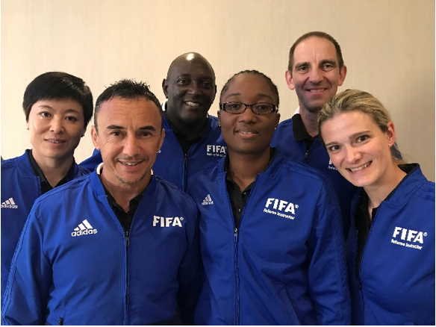
Thursday: REST day

Slide 12
Friday: Medium Intensity exercise
Set 1 (…) 35 min
Recovery / min
Total duration ± 35 min
Walking W … m
Jogging (MI) J +/- 6.650 m
Backwards BW … m
Sideways SW … m
High intensity HI 350 m
Sprint S … m
Total distance +/- 7.000 m
Referees & Assistant Referees
1 set of 35 min
35 min jog/run + (per 5 min 50m HI tempo-run)
35 min HI at 80% HRmax
Active recovery: /
Set 1 = 35 min
Total time: 35 min
The Medium Intensity Training (MI) is a combination of MI-jogging/running at (76-85% HRmax) and short HI-tempo runs (at 90% HRmax). This session you can perform on any ‘sportive’ surface as grass, forest, hard sand, …
Set 1: 35 min at 80% HRmax (+- 7km). In the middle of each 5 min of running, a tempo run over 50m has to be covered at 90% SPmax, or 7 x 50m in total.
Recovery: /
During these MI-sessions, the energy system should be aerobically. This kind of training should help you to increase the capacity to work aerobically and prepare in a progressive way for more intensive HI work. The tempo should be an ‘uncomfortable jog/run’.
.

Slide 13
Friday: Medium Intensity exercise – alternative
Alternative OUTDOOR
Referees & Assistant Referees
Min. 80 min cycling at 70% HRmax.
Alternative INDOOR
‘indoor-treadmill’-workload:
The Medium Intensity Training (MI) is a combination of MI-jogging/running at (76-85% HRmax) and short HI-tempo runs (at 90% HRmax).
Good to know!
Do not forget a nice warm up at the start and a cool down at the end!
The levels mentioned are just an indication. Adapt to your level and situation please.
Each brand (for example: Lifefitness; Technogym; …) uses an slightly different scale.
The same exercise as outside can be done inside.
Proposal: If you jog on Wednesday – bike on Friday or visa-versa
MI-workload ... TREADMILL ...
Level | Time (min) |  |  |  |  |  |  |  |  |  |  | TOTAL TIME
8
9
10
11 | 5 |  | 5 |  | … |  | … |  | 5 |  | 5 | 7x
12
13
14
15 |  | 0,15 |  | 0,15 |  | … |  | … |  | 0,15 |  | 6x
16
 |  |  |  |  |  |  |  |  |  |  |  | 36,40

Slide 14
Saturday: Speed exercise
One lap 1 min
Set 1 (5 laps) 5 min
Recovery 5 min
Set 2 (5 laps) 5 min
Total duration 15 min
Walking W 400 m
Jogging J 200 m
Backwards BW 100 m
Sideways SW 100 m
High intensity HI ---
Sprint S 320 m
Total distance 1120 m
2 sets of 5 laps
S
Start
J
BW
J
SW
W
S
Set 1: Sprint exercise in the penalty area: sprint from starting position – jog – backpedal – jog – sideways – sprint – return by walking. 5 laps make 1 set.
Recovery: 4-5 min (also recovery after each sprint by walking back)
Set 2: Repeat the same exercise.
Variation: start with a fast movement before sprinting. For example: high knees + sprint
Note: Perform each sprint at 100%! Increase the power of the first 3-4 sprint steps.
The personal coach can ad a signal, for example a visual signal as in the game.

Slide 15
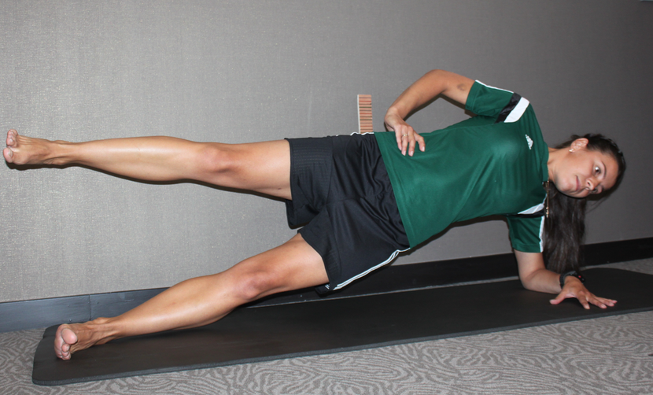
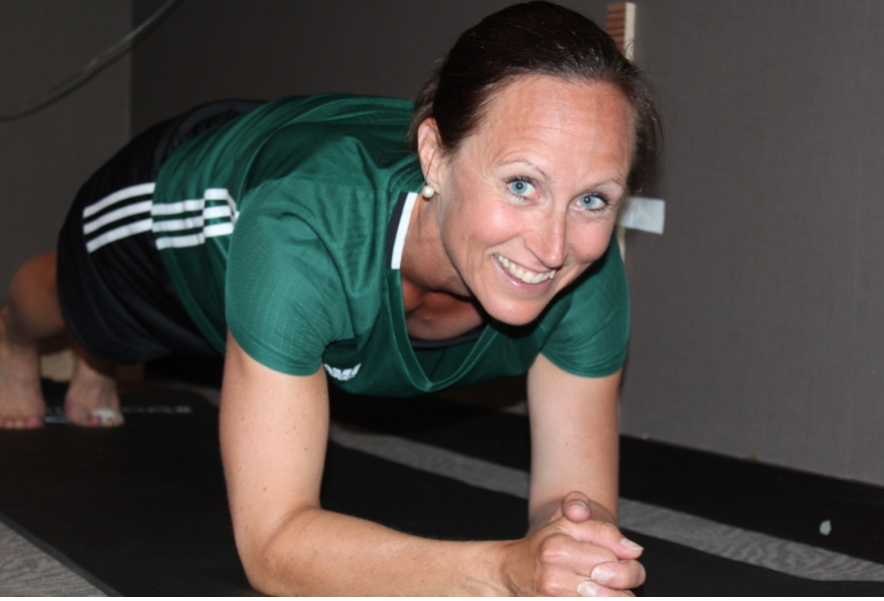
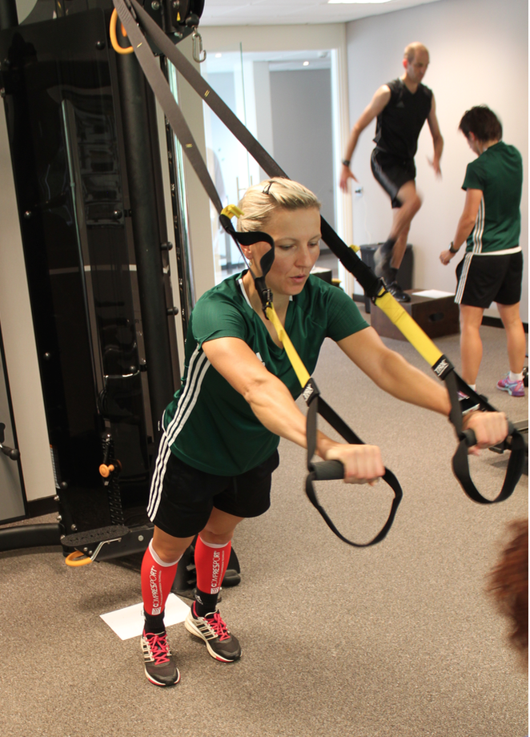
Sunday: CORE & basic strength exercises
1 set of 30 min
Perform minimal the exercises below, you can do additional exercises if you like …
Lying on your Stomach with Arms Crossing and Legs Lift (back muscles)
Lie on your stomach. Lift your arms and legs up (+/- 15 cm above the ground).
Exercise: Alternately cross your arms.
Note that you always look to the ground!
2 x 30 sec
Cross country Skiing (m. quadriceps)
Balance on one leg. Weight on the mid part of your foot.
Exercise: Flex and extend the knee of the supporting leg and swing the arms in opposite direction in the same rhythm.
Do not let your knee cave inward.
2 x 30 sec (each leg)
Push-ups with Knee and Diagonal Hand Support (m. pectoralis)
Lie on your stomach. Place your hands diagonally. (Additionally you can put you on your knees)
Exercise: Push your body up and perform push-ups.
The body should be completely straight. Noise to the ground.
2 x 20 reps (each side)
Sit-ups on Swiss ball (m. abdominis)
Lie on your back on the ball. Place your hands in your neck.
Exercise: bring your upper body slowly up and down.
Keep looking upwards!
2 x 20 reps
NOTE: increase every week with 1 set more (week 1= 2 sets; week 2 = 3 sets; …)
.

Slide 16
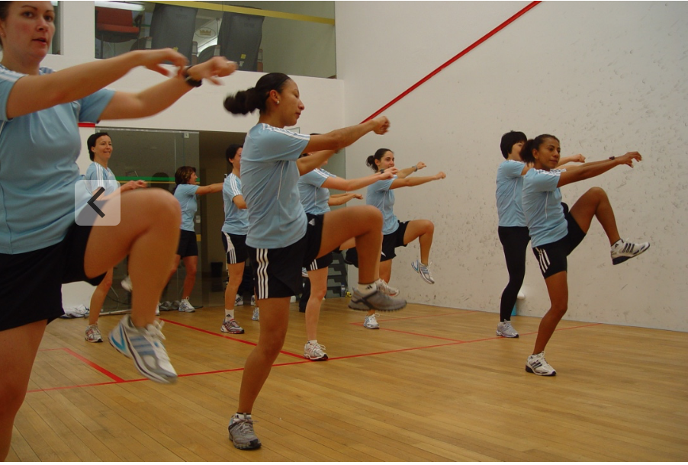
Sunday: Alternative … (weekend without game)
Moment of rest or …
No game can also be a moment of training some weaknesses you might have: strength, agility, starting speed, injury prevention, …
Alternatively,
Referees can also practice other intermittent sports they are familiar with (e.g., badminton, tennis, squash, or playing 5-aside soccer) to improve speed and agility.
To improve aerobic endurance race biking or mountain biking are also nice possibilities.
In general different activities are possible to benefit from complementary mental and physical stimulation.

Slide 17
Week 2 Fitness team

Slide 18
Week 2
With only a short break the intensity goes up again in the second week.
Monday Rest
Tuesday S / Agi&Coo / MI
Speed – reactive ex.
Agility & Coo icw Speed
MI-endurance run / jogging total time: 90 min
Wednesday Rest
Thursday Strength / S / HI
Strength
Extra Speed!
HI-endurance run total time: 90 min
Friday S
Speed work in preparation for the game total time: 60 min
Saturday GAME
Sunday AR
Active recovery total time: 60 min

Slide 19
Monday: REST day

Slide 20
Tuesday: Speed – reactive exercises
1 set of 30 min
‘Reactive exercises’ High jumps with two knees together up (10x) + sprint
3x 5 m; 3x 10 m; 3x 15 m
Step up and down on one step (10x) + sprint upstairs 5 to 10 m
5 reps
NOTE:
Perform each sprint at maximal speed!
Pay attention to your sprinting technique!
Active arm action in line with the body
Foot positioning (straight forwards)
Lean a little forward with the body
…
Take your time for a full recovery by walking back to start.

Slide 21
Tuesday: Speed & Coordination exercise
One lap 1,25 min
Set 1 (2 laps) 2,5 min
Recovery 4 min
Set 2 (2 laps) 2,5 min
Total duration 9 min
Walking W ---
Jogging J 160 m
Backwards BW ---
Sideways SW ---
Coordination Coo 100 m
High intensity HI ---
Sprint S 200 m
Total distance 460 m
2 sets of 2 laps
2 steps
1 step
Zigzag L&R
2 steps sideways
Zigzag Backwards
Set 1: Combine 5 coordination exercises (5 m) with a sprint in the mid circle. Sprint 10 m and decelerate 8 m before starting the next coordination exercise. Make 2 reps of each. (The picture indicates a bigger circle than the mid circle, but that’s only to have a clear indication.) The given exercises are just indications, you can choose other coordination exercises.
Recovery: 3 to 4 min active recovery in between sets
Set 2: Repeat the same exercise.
In total 20 sprints in the Centre circle.
Notes:
FIFA Ladies … ; April 12; …
…

Slide 22
Tuesday: Medium Intensity exercise
Set 1 (…) 35 min
Recovery / min
Total duration ± 35 min
Walking W … m
Jogging (MI) J +/- 6.300 m
Backwards BW … m
Sideways SW … m
High intensity HI 700 m
Sprint S … m
Total distance +/- 7.000 m
Referees & Assistant Referees
1 set of 35 min
35 min jog/run + (per 5 min 100m HI tempo-run)
35 min HI at 80% HRmax
Active recovery: /
Set 1 = 35 min
Total time: 35 min
The Medium Intensity Training (MI) is a combination of MI-jogging/running at (76-85% HRmax) and short HI-tempo runs (at 90% HRmax). This session you can perform on any ‘sportive’ surface as grass, forest, hard sand, …
Set 1: 35 min at 80% HRmax (+- 7km). In the middle of each 5 min of running, a tempo run over 100m has to be covered at 90% SPmax, or 7 x 100m in total.
Recovery: /
During these MI-sessions, the energy system should be aerobically. This kind of training should help you to increase the capacity to work aerobically and prepare in a progressive way for more intensive HI work. The tempo should be an ‘uncomfortable jog/run’.
.

Slide 23
Tuesday: Medium Intensity exercise – alternative
Alternative OUTDOOR
Referees & Assistant Referees
Min. 80 min cycling at 70% HRmax. Accelerate each 10 min for 30 sec.
Alternative INDOOR
‘indoor-treadmill’-workload:
The Medium Intensity Training (MI) is a combination of MI-jogging/running at (76-85% HRmax) and short HI-tempo runs (at 90% HRmax).
Good to know!
Do not forget a nice warm up at the start and a cool down at the end!
The levels mentioned are just an indication. Adapt to your level and situation please.
Each brand (for example: Lifefitness; Technogym; …) uses an slightly different scale.
The same exercise as outside can be done inside.
MI-workload ... TREADMILL ...
Level | Time (min) |  |  |  |  |  |  |  |  |  |  | TOTAL TIME
8
9
10
11
12 | 5 |  | 5 |  | … |  | … |  | 5 |  | 5 | 7x
13
14
15 |  | 0,20 |  | 0,20 |  | … |  | … |  | 0,20 |  | 6x
16
 |  |  |  |  |  |  |  |  |  |  |  | 37,00

Slide 24
Wednesday: REST day

Slide 25
Thursday: Speed & Agility exercise
2 sets of 2 reps
Referees & Assistant Referees
Set 1 (T-drill) 1 min
Recovery 3 min
Set 2 (Coda) 1 min
Total duration ± 5 min
Walking W … m
Jogging J … m
Backwards BW 20 m
Sideways SW 72 m
High intensity HI … m
Sprint S 60 m
Total distance 152 m
10 m
B.
10 m
A.
Start
C.
SW
Start
S
8 m
BW
10 m
T-drill: Sprint 10m (touch the cone A.) – sideways R (touch cone B.) – sideways L to the other end (touch cone C.) – sideways R (touch cone A.) – backwards to the finish line
A second time: start Left side instead of Right side.
(By preference timed with micro gate)
Recovery: 3 to 4 min
CODA-drill: Sprint 10m (one foot lined up with the cone) – 2x side ways (L&R) 8m – sprint back to the finish line. 2 reps in total to perform. Exercise must be done at maximum speed but respecting correct technique of sideways run and touching the course lines with the forward foot.
(By preference timed with micro gate)

Slide 26
Thursday: High Intensity exercise – YoYo & ARIET
3 sets of x reps
Assistant Referees
Referees
Set 1 (R) 5 min
Recovery 3 min
Set 2 (R) 5 min
Recovery 3 min
Set 3 (R) 3,5 min
Total duration ± 21,5 min
Walking W 305 m
Jogging J … m
Backwards BW … m
Sideways SW … m
High intensity HI 2440 m
Sprint S … m
Total distance ± 2745 m
Start
Start
HI
HI
W 10”
W 5”
W 5”
12,5 m
5 m
20 m
2,5 m
20 m
Referees: Yo-Yo based: Yo-Yo Intermittent Recovery test Level 1
Set 1: level 5.1 – 14.6 (+/- 5 min 41)
Set 2: level 14.7 – 16.6 (+/- 5 min)
Set 3: level 15.5 – 16.8 (+/- 3,5 min) Recovery: 3 min in between sets
Assistant Referees: ARIET based: Yo-Yo Intermittent Endurance test Level 2
Set 1: level 8.0 (1) – 13.5 (2) (+/- 4 min)
Set 2: level 13.5 (3) – 14.5 (3) (+/- 4 min)
Set 3: level 13.5 (6) – 15.0 (3) (+/- 4 min) Recovery: 3 min in between sets

Slide 27
Thursday: (UEFA) High Intensity exercise – SDS
Set 1 (5 laps) 10 min
Recovery 4 min
Set 2 (5 laps) 10 min
Total duration ± 24 min
Walking W 400 m
Jogging J … m
Backwards BW … m
Sideways SW … m
High intensity HI 2350 m
Sprint S … m
Total distance 2750 m
Referees
2 sets of SDS
Start
20 sec
HI
W 5”
15 sec
W 5”
W 60”
15 sec
Special preparation for the new SDS test at the Winter Course in Lisbon.
Based on SDS (single – double – single) Paul BALSOM (Leicester City Fitness Coach)
Set 1: 5 laps of (100m ‘Single’ + 5 sec recovery + 65m with turn ‘Double’ + 5 sec recovery + 75m ‘Single’)
Recovery: 4 min
Set 2: Repeat the same exercise.
Time: 10 min + 4 + 10 = 22 min; 2350m in total

Slide 28
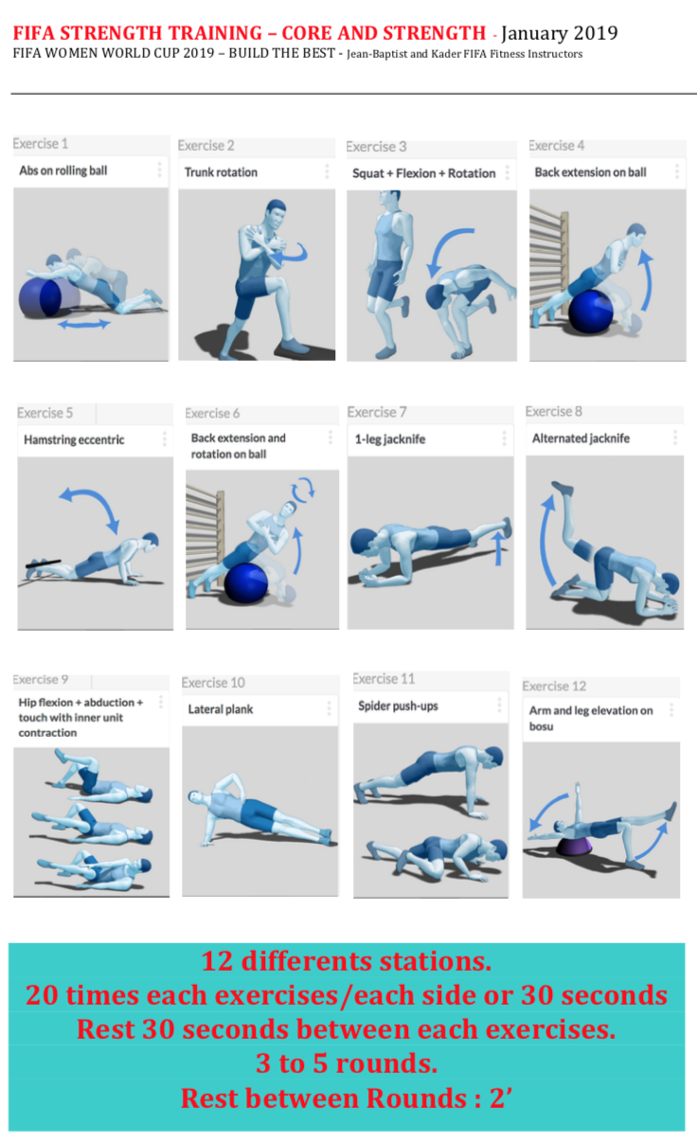
Thursday: Strength exercises

Slide 29
Friday: Speed exercise
One lap 1 min
Set 1 (3 laps) 3 min
Recovery 2 min
Set 2 (3 laps) 3 min
Recovery 2 min
Set 3 (4 laps) 4 min
Recovery 2 min
Set 4 (8 laps) 10 min
Total duration +- 26 min
Walking W 630 m
Jogging J ---
Backwards BW 15 m
Sideways SW 20 m
High intensity HI 480 m
Sprint S 115 m
Total distance +- 1.260 m
4 sets of x laps
Coo
15m
SW
5m
10m
BW
S
60m
W
J
HI
The speed exercise consist of 4 different sets:
1 set of 3 sprints 15 m front. ; rest 45” and 2’
1 set of 3 sprints 5m back + 10m front. ; rest 45” and 2’
1 set of 4 sprints 2 SW left + 2 SW right (5m sideways +10m front ) ; rest 45” and 2’
1 set of 6 to 8 x 60 m – progressive accelerations (not to fast), control your body and running style ; rest 60”
Note: Perform each sprint at 100%! Increase the power of the first 3-4 sprint steps.
The personal coach can ad a signal, for example a visual signal as in the game.

Slide 30
Saturday: Game

Slide 31
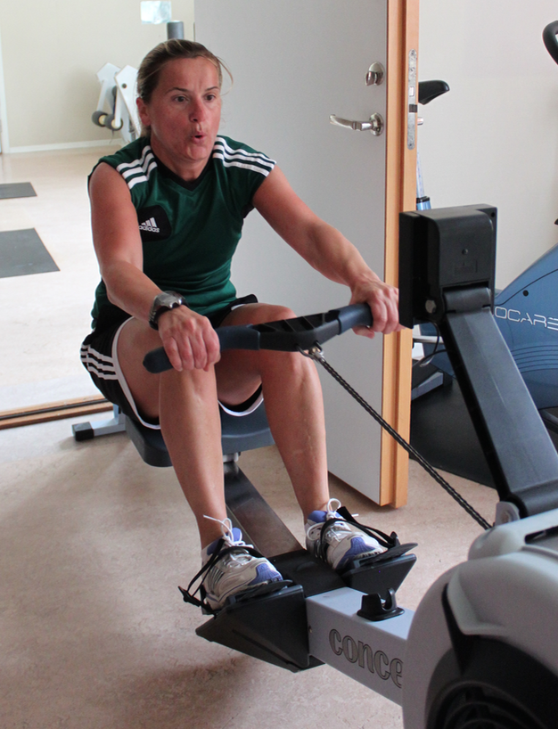
Sunday: Active Recovery - Light Intensity exercise
1 set of 30 min
Active recovery (AR)
10’ warm up (walking & jogging on a treadmill between 09 & 12 km/hr, followed by mobilisation exercises)
30’ non-weight bearing exercises (70-75% HRmax), such as: 15’ cycling (80-90 cycles/min); 5’ rowing (33-38 cycles/min); 10’ gliding / stepping (65-75 cycles/min)
10’ CORE exercises (should be done on a daily bases)
10’ extensive stretching, followed by Sauna, Jacuzzi, massage, …
Total duration: +/-60 min
During these LI-sessions or Active recovery, the energy system is aerobically and the impact on the joints should be low. This kind of training should help you to recover better after an intense training or game. The tempo should be an ‘comfortable jog/run’.
.

Slide 32
Week 3 Fitness team

Slide 33
Week 3
Normal week with game on Saturday.
Monday CORE
Extra CORE & basic strength exercises total time: 50 min
Tuesday S / Agi&Coo / MI-(HI)
Speed – reactive ex.
Agility & Coo icw Speed
MI (-HI)-endurance run / jogging total time: 90 min
Wednesday Rest
Thursday Strength / S / HI
Strength
Extra Speed!
HI-endurance run total time: 90 min
Friday S
Speed work in preparation for the game total time: 60 min
Saturday GAME
Sunday AR
Active recovery total time: 60 min

Slide 34
Sunday: CORE & basic strength exercises
1 set of 30 min
Perform minimal the exercises below, you can do additional exercises if you like …
Lying on your Stomach with Arms Crossing and Legs Lift (back muscles)
Lie on your stomach. Lift your arms and legs up (+/- 15 cm above the ground).
Exercise: Alternately cross your arms.
Note that you always look to the ground!
2 x 30 sec
Cross country Skiing (m. quadriceps)
Balance on one leg. Weight on the mid part of your foot.
Exercise: Flex and extend the knee of the supporting leg and swing the arms in opposite direction in the same rhythm.
Do not let your knee cave inward.
2 x 30 sec (each leg)
Push-ups with Knee and Diagonal Hand Support (m. pectoralis)
Lie on your stomach. Place your hands diagonally. (Additionally you can put you on your knees)
Exercise: Push your body up and perform push-ups.
The body should be completely straight. Noise to the ground.
2 x 20 reps (each side)
Sit-ups on Swiss ball (m. abdominis)
Lie on your back on the ball. Place your hands in your neck.
Exercise: bring your upper body slowly up and down.
Keep looking upwards!
2 x 20 reps
NOTE: increase every week with 1 set more (week 1= 2 sets; week 2 = 3 sets; …)
.

Slide 35
Tuesday: Speed – reactive exercises
‘Reactive exercises’
‘Superstars’ (10x) + sprint
3x 5 m; 3x 10 m
‘Superstars’:
Feet and hands on the ground position
Move your feet as fast as possible forwards & backwards on the ground (hands stay on the ground)
It gives the impression you ‘sprint’ on the spot.
‘Squat position’ + high knees + sprint
2x 15 m; 2x 20 m
‘Squat position’: Put yourself with your back straight to the wall; knees 90°; hold this position for 20 sec (you feel the tension in your quadriceps)
Immediately after the 20 sec ‘squat position’, high knees on the spot for 3 sec + full sprint
Total of 115 m at full speed.
NOTE:
Perform each sprint at maximal speed!
Pay attention to your sprinting technique!
Active arm action in line with the body
Foot positioning (straight forwards)
Lean a little forward with the body
…
Take your time for a full recovery by walking back to start.
1 set of 30 min

Slide 36
Tuesday: Speed & Agility exercise
Set 1 (5 sprints) 5 min
Recovery 5 min
Set 2 (5 sprints) 5 min
Total duration 15 min
Walking W 160 m
Jogging J ---
Backwards BW ---
Sideways SW ---
High intensity HI ---
Sprint S 160 m
Total distance 320 m
2 sets of 5 sprints
Variation:
Set 1: 5x 10m
Set 2: 4x 15m
Set 3: 3x 30m
Set 4: 4x 15m
Set 5: 5x 10m
1 min recovery in between sets
Total time: 15’
Distance 310m
Start
W
S
10m
S
15m
S
30m
S
15m
BW
S
10m
10m
Set 1: 5 different sprinting exercises make 1 set; walk back slowly after every sprint; start each run on every 60 sec 1. Walk + sprint 2. Sideways R & L + sprint (side-stepping)
3. High Knees + sprint 4. Zigzag shuffle L & R + sprint 5. Backwards/turn + sprint
Recovery: 5 min
Set 2: Same exercise, again 5 sprints.
Eventually: Set 3: Same exercise, again 5 sprints. (3x 80m = 240m sprint)
After every sprint, a very slow walk back to the start position is a good way of determining the recovery (e.g. 20” for 10m; 30” for 15m and 40” for 30m)

Slide 37
Tuesday: Medium Intensity exercise
Set 1 (…) 45 min
Recovery / min
Total duration ± 45 min
Walking W … m
Jogging (MI) J +/- 8550 m
Backwards BW … m
Sideways SW … m
High intensity HI 450 m
Sprint S … m
Total distance +/- 9.000 m
Referees & Assistant Referees
1 set of 45 min
45 min jog/run + (per 5 min 50m HI tempo-run)
45 min HI at 80% HRmax
Active recovery: /
Set 1 = 45 min
Total time: 45 min
The Medium Intensity Training (MI) is a combination of MI-jogging/running at (76-85% HRmax) and short HI-tempo runs (at 90% HRmax). This session you can perform on any ‘sportive’ surface as grass, forest, hard sand, …
Set 1: 45 min at 80% HRmax (+/- 9km). In the middle of each 5 min of running, a tempo run over 50m has to be covered at 90% SPmax, or 9 x 50 m in total.
Recovery: /
During these MI-sessions, the energy system should be aerobically. This kind of training should help you to increase the capacity to work aerobically and prepare in a progressive way for more intensive HI work. The tempo should be an ‘uncomfortable jog/run’.
.

Slide 38
Thursday: Medium-High Intensity exercise – alternative
Alternative OUTDOOR
Referees & Assistant Referees
Min. 120 min cycling at 70% HRmax. Accelerate each 10 min for 30 sec.
Alternative INDOOR
‘indoor-treadmill’-workload:
The Medium-High Intensity Training (MI-HI) is a combination of MI-jogging/running at (76-85% HRmax) and short HI-tempo runs (at 90% HRmax).
Good to know!
Do not forget a nice warm up at the start and a cool down at the end!
The levels mentioned are just an indication. Adapt to your level and situation please.
Each brand (for example: Lifefitness; Technogym; …) uses an slightly different scale.
The same exercise as outside can be done inside.
MI-workload ... TREADMILL ...
Level | Time (min) |  |  |  |  |  |  |  |  |  |  | TOTAL TIME
8
9
10
11
12 | 5 |  | 5 |  | … |  | … |  | 5 |  | 5 | 9x
13
14
15 |  | 0,20 |  | 0,20 |  | … |  | … |  | 0,20 |  | 8x
16
 |  |  |  |  |  |  |  |  |  |  |  | 47,40

Slide 39
Wednesday: REST day

Slide 40
Thursday: Speed & Agility exercise
2 sets of 2 reps
Referees & Assistant Referees
Set 1 (T-drill) 1 min
Recovery 3 min
Set 2 (Coda) 1 min
Total duration ± 5 min
Walking W … m
Jogging J … m
Backwards BW 20 m
Sideways SW 72 m
High intensity HI … m
Sprint S 60 m
Total distance 152 m
10 m
B.
10 m
A.
Start
C.
SW
Start
S
8 m
BW
10 m
T-drill: Sprint 10m (touch the cone A.) – sideways R (touch cone B.) – sideways L to the other end (touch cone C.) – sideways R (touch cone A.) – backwards to the finish line
A second time: start Left side instead of Right side.
(By preference timed with micro gate)
Recovery: 3 to 4 min
CODA-drill: Sprint 10m (one foot lined up with the cone) – 2x side ways (L&R) 8m – sprint back to the finish line. 2 reps in total to perform. Exercise must be done at maximum speed but respecting correct technique of sideways run and touching the course lines with the forward foot.
(By preference timed with micro gate)

Slide 41
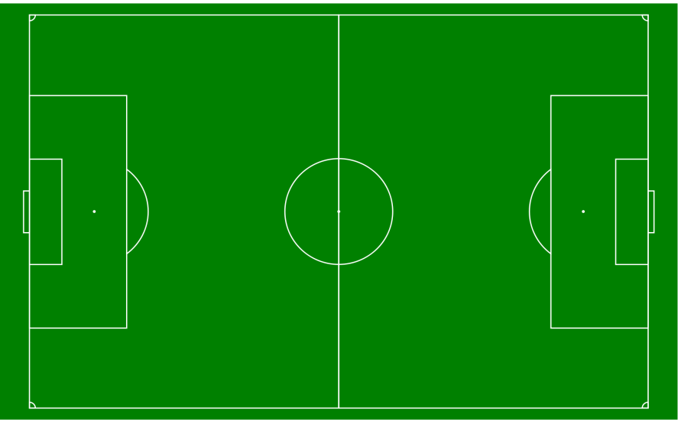
Thursday: High Intensity intermittent exercise
Set 1 (6 laps) 14,80 min
Recovery 4 min
Set 2 (6 laps) 14,80 min
Total duration ± 33,60 min
Walking W 1.200 m
Jogging J … m
Backwards BW … m
Sideways SW … m
High intensity HI 3.600 m
Sprint S … m
Total distance 4.800 m
Referees
2 sets of 6 laps
12,5m. walk
75m. run
12,5m. walk
75m. run
25m walk
VARIATION ON FOOTBALL FIELD
Referees & Assistant-Referees: based on FIFA fitness test
Files 17”-20” (75m HI in 17’’ and 25 walk in 20’’) Depending on the level! See extra chart last month.
Set 1: 6 laps (or 24 accelerations) 17”-20” Referees / 17”-22” Assistant-Referees
Recovery: 3 to 4 min in between
Set 2: again 6 laps (or 24 accelerations) 17”-20” or 17”-22”
Variation: 17”-17” & 17”-20” Ladies international FIFA

Slide 42
Thursday: (UEFA) High Intensity exercise – SDS
Set 1 (…) 7,5 min
Recovery 4 min
Set 2 (…) 7,5 min
Total duration ± 19 min
Walking W 300 m
Jogging J … m
Backwards BW … m
Sideways SW … m
High intensity HI 2100 m
Sprint S … m
Total distance 2400 m
Referees
2 sets of SDS
W 35”
Start
HI
14 sec
14 sec
14 sec
W 5”
W 5”
Special preparation for the new SDS test at the Winter Course in Lisbon.
Based on SDS (single – double – single) Paul BALSOM (Leicester City Fitness Coach)
Set 1: 5 laps of (75m ‘Single’ + 5 sec recovery + 65m with turn ‘Double’ + 5 sec recovery + 75m ‘Single’)
Recovery: 4 min
Set 2: Repeat the same exercise.
Time: 7,5 min + 4 + 7,5 = 19 min; 2100m in total

Slide 43
Thursday: Strength exercises

Slide 44
Friday: Speed exercise
One lap 1 min
Set 1 (5 laps) 5 min
Recovery 5 min
Set 2 (5 laps) 5 min
Total duration 15 min
Walking W 400 m
Jogging J 200 m
Backwards BW 100 m
Sideways SW 100 m
High intensity HI ---
Sprint S 320 m
Total distance 1120 m
2 sets of 5 laps
S
Start
J
BW
J
SW
W
S
Set 1: Sprint exercise in the penalty area: sprint from starting position – jog – backpedal – jog – sideways – sprint – return by walking. 5 laps make 1 set.
Recovery: 4-5 min (also recovery after each sprint by walking back)
Set 2: Repeat the same exercise.
Variation: start with a fast movement before sprinting. For example: high knees + sprint
Note: Perform each sprint at 100%! Increase the power of the first 3-4 sprint steps.
The personal coach can ad a signal, for example a visual signal as in the game.

Slide 45
Saturday: Game

Slide 46
Sunday: Active Recovery - Light Intensity exercise
1 set of 30 min
Active recovery (AR)
10’ warm up (walking & jogging on a treadmill between 09 & 12 km/hr, followed by mobilisation exercises)
30’ non-weight bearing exercises (70-75% HRmax), such as: 15’ cycling (80-90 cycles/min); 5’ rowing (33-38 cycles/min); 10’ gliding / stepping (65-75 cycles/min)
10’ CORE exercises (should be done on a daily bases)
10’ extensive stretching, followed by Sauna, Jacuzzi, massage, …
Total duration: +/-60 min
During these LI-sessions or Active recovery, the energy system is aerobically and the impact on the joints should be low. This kind of training should help you to recover better after an intense training or game. The tempo should be an ‘comfortable jog/run’.
.

Slide 47
Week 4 Fitness team

Slide 48
Week 4
Normal week with game on Saturday.
Monday CORE
Extra CORE & basic strength exercises total time: 50 min
Tuesday S / Agi&Coo / MI
Speed – reactive ex.
Agility & Coo icw Speed
MI-endurance run / jogging total time: 90 min
Wednesday Rest
Thursday Strength / S / HI
Strength
Extra Speed!
HI-endurance run total time: 90 min
Friday S
Speed work in preparation for the game total time: 60 min
Saturday GAME
Sunday AR
Active recovery total time: 60 min

Slide 49
Sunday: CORE & basic strength exercises
1 set of 30 min
Perform minimal the exercises below, you can do additional exercises if you like …
Lying on your Stomach with Arms Crossing and Legs Lift (back muscles)
Lie on your stomach. Lift your arms and legs up (+/- 15 cm above the ground).
Exercise: Alternately cross your arms.
Note that you always look to the ground!
2 x 30 sec
Cross country Skiing (m. quadriceps)
Balance on one leg. Weight on the mid part of your foot.
Exercise: Flex and extend the knee of the supporting leg and swing the arms in opposite direction in the same rhythm.
Do not let your knee cave inward.
2 x 30 sec (each leg)
Push-ups with Knee and Diagonal Hand Support (m. pectoralis)
Lie on your stomach. Place your hands diagonally. (Additionally you can put you on your knees)
Exercise: Push your body up and perform push-ups.
The body should be completely straight. Noise to the ground.
2 x 20 reps (each side)
Sit-ups on Swiss ball (m. abdominis)
Lie on your back on the ball. Place your hands in your neck.
Exercise: bring your upper body slowly up and down.
Keep looking upwards!
2 x 20 reps
NOTE: increase every week with 1 set more (week 1= 2 sets; week 2 = 3 sets; …)
.

Slide 50
Tuesday: Speed – reactive exercises
1 set of 30 min
‘Reactive exercises’
High jumps with two knees together up (10x) + sprint
3x 5 m; 3x 10 m; 3x 15 m
Step up and down on one step (10x) + sprint upstairs 5 to 10 m
5 reps
NOTE:
Perform each sprint at maximal speed!
Pay attention to your sprinting technique!
Active arm action in line with the body
Foot positioning (straight forwards)
Lean a little forward with the body
…
Take your time for a full recovery by walking back to start.

Slide 51
Tuesday: Speed & Coordination exercise
One lap 1,25 min
Set 1 (2 laps) 2,5 min
Recovery 4 min
Set 2 (2 laps) 2,5 min
Total duration 9 min
Walking W ---
Jogging J 160 m
Backwards BW ---
Sideways SW ---
Coordination Coo 100 m
High intensity HI ---
Sprint S 200 m
Total distance 460 m
2 sets of 2 laps
2 steps
1 step
Zigzag L&R
2 steps sideways
Zigzag Backwards
Set 1: Combine 5 coordination exercises (5 m) with a sprint in the mid circle. Sprint 10 m and decelerate 8 m before starting the next coordination exercise. Make 2 reps of each. (The picture indicates a bigger circle than the mid circle, but that’s only to have a clear indication.) The given exercises are just indications, you can choose other coordination exercises.
Recovery: 3 to 4 min active recovery in between sets
Set 2: Repeat the same exercise.
In total 20 sprints in the Centre circle.
Notes:
FIFA Ladies … ; April 12; …
…

Slide 52
Tuesday: Medium Intensity exercise
Set 1 (…) 30 min
Recovery / min
Total duration ± 30 min
Walking W … m
Jogging(MI) J +/- 5.100 m
Backwards BW … m
Sideways SW … m
High intensity HI 900 m
Sprint S … m
Total distance +/- 6.000 m
Referees & Assistant Referees
1 set of 30 min
30 min jog/run + (per 2,5 min 50/100m HI tempo-run)
30 min HI at 76% HRmax
Active recovery: /
Set 1 = 30 min
Total time: 30 min
The Medium Intensity Training (MI) is a combination of MI-jogging/running at (76-85% HRmax) and short HI-tempo runs (at 90% HRmax). This session you can perform on any ‘sportive’ surface as grass, forest, hard sand, …
Set 1: 30 min at 76% HRmax (+/- 6km). For each 5 min of running, 2 tempo runs have to be done: in the middle a 50m tempo run, and towards the end of the 5’ period a 100m tempo run has to be covered.
Recovery: /
During these MI-sessions, the energy system should be aerobically. This kind of training should help you to increase the capacity to work aerobically and prepare in a progressive way for more intensive HI work. The tempo should be an ‘uncomfortable jog/run’.
.

Slide 53
Tuesday: Medium-High Intensity exercise – alternative
Alternative OUTDOOR
Referees & Assistant Referees
Min. 120 min cycling at 75% HRmax. Accelerate each 10 min for 45 sec.
Alternative INDOOR
‘indoor-treadmill’-workload:
The Medium-High Intensity Training (MI-HI) is a combination of MI-jogging/running at (76-85% HRmax) and short HI-tempo runs (at 90% HRmax).
Good to know!
Do not forget a nice warm up at the start and a cool down at the end!
The levels mentioned are just an indication. Adapt to your level and situation please.
Each brand (for example: Lifefitness; Technogym; …) uses an slightly different scale.
The same exercise as outside can be done inside.
MI-HI-workload ... TREADMILL ...
Level | Time (min) |  |  |  |  |  |  |  |  |  |  | TOTAL TIME
8
9
10
11
12
13 | 2,5 |  | 2,5 |  | ... | ... | 2,5 |  | 2,5 |  |  | 12x
14
15
16 |  | 0,15 |  | 0,20 |  |  |  | 0,15 |  | 0,20 |  | 11x
 |  |  |  |  |  |  |  |  |  |  |  | 30' + 3'

Slide 54
Wednesday: REST day

Slide 55
Thursday: Speed & Agility exercise
2 sets of 2 reps
Referees & Assistant Referees
Set 1 (T-drill) 1 min
Recovery 3 min
Set 2 (Coda) 1 min
Total duration ± 5 min
Walking W … m
Jogging J … m
Backwards BW 20 m
Sideways SW 72 m
High intensity HI … m
Sprint S 60 m
Total distance 152 m
10 m
B.
10 m
A.
Start
C.
SW
Start
S
8 m
BW
10 m
T-drill: Sprint 10m (touch the cone A.) – sideways R (touch cone B.) – sideways L to the other end (touch cone C.) – sideways R (touch cone A.) – backwards to the finish line
A second time: start Left side instead of Right side.
(By preference timed with micro gate)
Recovery: 3 to 4 min
CODA-drill: Sprint 10m (one foot lined up with the cone) – 2x side ways (L&R) 8m – sprint back to the finish line. 2 reps in total to perform. Exercise must be done at maximum speed but respecting correct technique of sideways run and touching the course lines with the forward foot.
(By preference timed with micro gate)

Slide 56
Thursday: High Intensity exercise – YoYo & ARIET
3 sets of x reps
Assistant Referees
Referees
Set 1 (R) 5 min
Recovery 3 min
Set 2 (5) 5 min
Recovery 3 min
Set 3 (R) 3 min
Total duration ± 21 min
Walking W 430 m
Jogging J … m
Backwards BW … m
Sideways SW … m
High intensity HI 1.720 m
Sprint S … m
Total distance ± 2.150 m
Start
Start
HI
HI
W 10”
W 5”
W 5”
12,5 m
5 m
20 m
2,5 m
20 m
Referees: Yo-Yo based: Yo-Yo Intermittent Recovery test Level 1
Set 1: level 5.1 – 14.6 (+/- 5min 41)
Set 2: level 14.1 – 15.8 (+/- 5 min)
Set 3: level 16.1 – 17.2 (+/- 3 min) Recovery: 3 min in between sets
Assistant Referees: ARIET based: Yo-Yo Intermittent Endurance test Level 2
Set 1: level 8.0 (1) – 13.5 (2) (+/- 4 min)
Set 2: level 13.0 (1) – 14.0 (5) (+/- 5 min)
Set 3: level 14.0 (6) – 15.5 (4) (+/- 3 min) Recovery: 3 min in between sets

Slide 57
Thursday: (UEFA) High Intensity exercise – SDS
Set 1 (5) 4,5 min
Recovery 4 min
Set 2 (5) 4,5 min
Recovery 4 min
Set 3 (5) 4,5 min
Total duration ± 21,5 min
Walking W 225 m
Jogging J … m
Backwards BW … m
Sideways SW … m
High intensity HI 2880 m
Sprint S … m
Total distance 3105 m
Referees
3 set of SDS
20 m
4 m
Start
HI
W 12”
W 5”
36 m
Special preparation for the new SDS test at the Winter Course in Lisbon.
SDS (single – double – single) Paul BALSOM (Leicester City Fitness Coach)
Set 1: 5 laps of (12 sec single HI run – 5 sec rest – 16 sec double HI run – 5 sec rest – 12 sec single HI run – 12 sec rest)
Recovery: 4 min
Set2 & 3: repeat the same 5 laps
Target tempo 18 km/h: Single: 12 sec & Double: 16 sec; Single = 60 m & Double = 72 m

Slide 58
Thursday: Strength exercises

Slide 59
Friday: Speed exercise
One lap 1 min
Set 1 (3 laps) 3 min
Recovery 2 min
Set 2 (3 laps) 3 min
Recovery 2 min
Set 3 (4 laps) 4 min
Recovery 2 min
Set 4 (8 laps) 10 min
Total duration +- 26 min
Walking W 630 m
Jogging J ---
Backwards BW 15 m
Sideways SW 20 m
High intensity HI 480 m
Sprint S 115 m
Total distance +- 1.260 m
4 sets of x laps
Coo
15m
SW
5m
10m
BW
S
60m
W
J
HI
The speed exercise consist of 4 different sets:
1 set of 3 sprints 15 m front. ; rest 45” and 2’
1 set of 3 sprints 5m back + 10m front. ; rest 45” and 2’
1 set of 4 sprints 2 SW left + 2 SW right (5m sideways +10m front ) ; rest 45” and 2’
1 set of 6 to 8 x 60 m – progressive accelerations (not to fast), control your body and running style ; rest 60”
Note: Perform each sprint at 100%! Increase the power of the first 3-4 sprint steps.
The personal coach can ad a signal, for example a visual signal as in the game.

Slide 60
Saturday: Game

Slide 61
Sunday: Active Recovery - Light Intensity exercise
1 set of 30 min
Active recovery (AR)
10’ warm up (walking & jogging on a treadmill between 09 & 12 km/hr, followed by mobilisation exercises)
30’ non-weight bearing exercises (70-75% HRmax), such as: 15’ cycling (80-90 cycles/min); 5’ rowing (33-38 cycles/min); 10’ gliding / stepping (65-75 cycles/min)
10’ CORE exercises (should be done on a daily bases)
10’ extensive stretching, followed by Sauna, Jacuzzi, massage, …
Total duration: +/-60 min
During these LI-sessions or Active recovery, the energy system is aerobically and the impact on the joints should be low. This kind of training should help you to recover better after an intense training or game. The tempo should be an ‘comfortable jog/run’.
.

Slide 62
Week 5 Fitness team

Slide 63
Week 5
Normal week with game on Saturday.
Monday CORE
Extra CORE & basic strength exercises total time: 50 min
Tuesday S / Agi&Coo / MI
Speed – reactive ex.
Agility & Coo icw Speed
MI-endurance run / jogging total time: 90 min
Wednesday Rest
Thursday Strength / S / HI
Strength
Extra Speed!
HI-endurance run total time: 90 min

Slide 64
Sunday: CORE & basic strength exercises
1 set of 30 min
Perform minimal the exercises below, you can do additional exercises if you like …
Lying on your Stomach with Arms Crossing and Legs Lift (back muscles)
Lie on your stomach. Lift your arms and legs up (+/- 15 cm above the ground).
Exercise: Alternately cross your arms.
Note that you always look to the ground!
2 x 30 sec
Cross country Skiing (m. quadriceps)
Balance on one leg. Weight on the mid part of your foot.
Exercise: Flex and extend the knee of the supporting leg and swing the arms in opposite direction in the same rhythm.
Do not let your knee cave inward.
2 x 30 sec (each leg)
Push-ups with Knee and Diagonal Hand Support (m. pectoralis)
Lie on your stomach. Place your hands diagonally. (Additionally you can put you on your knees)
Exercise: Push your body up and perform push-ups.
The body should be completely straight. Noise to the ground.
2 x 20 reps (each side)
Sit-ups on Swiss ball (m. abdominis)
Lie on your back on the ball. Place your hands in your neck.
Exercise: bring your upper body slowly up and down.
Keep looking upwards!
2 x 20 reps
NOTE: increase every week with 1 set more (week 1= 2 sets; week 2 = 3 sets; …)
.

Slide 65
Tuesday: Speed – reactive exercises
‘Reactive exercises’
‘Superstars’ (10x) + sprint
3x 5 m; 3x 10 m
‘Superstars’:
Feet and hands on the ground position
Move your feet as fast as possible forwards & backwards on the ground (hands stay on the ground)
It gives the impression you ‘sprint’ on the spot.
‘Squat position’ + high knees + sprint
2x 15 m; 2x 20 m
‘Squat position’: Put yourself with your back straight to the wall; knees 90°; hold this position for 20 sec (you feel the tension in your quadriceps)
Immediately after the 20 sec ‘squat position’, high knees on the spot for 3 sec + full sprint
Total of 115 m at full speed.
NOTE:
Perform each sprint at maximal speed!
Pay attention to your sprinting technique!
Active arm action in line with the body
Foot positioning (straight forwards)
Lean a little forward with the body
…
Take your time for a full recovery by walking back to start.
1 set of 30 min

Slide 66
Tuesday: Speed & Agility exercise
Set 1 (5 sprints) 5 min
Recovery 5 min
Set 2 (5 sprints) 5 min
Total duration 15 min
Walking W 160 m
Jogging J ---
Backwards BW ---
Sideways SW ---
High intensity HI ---
Sprint S 160 m
Total distance 320 m
2 sets of 5 sprints
Variation:
Set 1: 5x 10m
Set 2: 4x 15m
Set 3: 3x 30m
Set 4: 4x 15m
Set 5: 5x 10m
1 min recovery in between sets
Total time: 15’
Distance 310m
Start
W
S
10m
S
15m
S
30m
S
15m
BW
S
10m
10m
Set 1: 5 different sprinting exercises make 1 set; walk back slowly after every sprint; start each run on every 60 sec 1. Walk + sprint 2. Sideways R & L + sprint (side-stepping)
3. High Knees + sprint 4. Zigzag shuffle L & R + sprint 5. Backwards/turn + sprint
Recovery: 5 min
Set 2: Same exercise, again 5 sprints.
Eventually: Set 3: Same exercise, again 5 sprints. (3x 80m = 240m sprint)
After every sprint, a very slow walk back to the start position is a good way of determining the recovery (e.g. 20” for 10m; 30” for 15m and 40” for 30m)

Slide 67
Tuesday: Medium Intensity exercise
Set 1 (…) 30 min
Recovery / min
Total duration ± 30 min
Walking W … m
Jogging (MI) J +/- 5.100 m
Backwards B … m
Sideways SW … m
High intensity HI 900 m
Sprint S … m
Total distance +/- 6.000 m
Referees & Assistant Referees
1 set of 30 min
32 min jog/run + (per 4 min 30 sec HI tempo-run)
30 min HI at 76% HRmax
Active recovery: /
Set 1 = 30 min
Total time: 30 min
The Medium Intensity Training (MI) is a combination of MI-jogging/running at (76-85% HRmax) and short HI-tempo runs (at 90% HRmax). This session you can perform on any ‘sportive’ surface as grass, forest, hard sand, …
Set 1: 32 min at 76% HRmax (+/- 6km). At the end of each 4 min period, a 30 sec tempo run has to be performed (> 150m), or 6 all together resulting in a total distance of 900m.
Recovery: /
During these MI-sessions, the energy system should be aerobically. This kind of training should help you to increase the capacity to work aerobically and prepare in a progressive way for more intensive HI work. The tempo should be an ‘uncomfortable jog/run’.
.

Slide 68
Tuesday: Medium-High Intensity exercise – alternative
Alternative OUTDOOR
Referees & Assistant Referees
Min. 120 min cycling at 75% HRmax. Accelerate each 8 min for 45 sec.
Alternative INDOOR
‘indoor-treadmill’-workload:
The Medium-High Intensity Training (MI-HI) is a combination of MI-jogging/running at (76-85% HRmax) and short HI-tempo runs (at 90% HRmax).
Good to know!
Do not forget a nice warm up at the start and a cool down at the end!
The levels mentioned are just an indication. Adapt to your level and situation please.
Each brand (for example: Lifefitness; Technogym; …) uses an slightly different scale.
The same exercise as outside can be done inside.
MI/HI-workload ... TREADMILL ...
Level | Time (min) |  |  |  |  |  |  |  |  |  |  | TOTAL TIME
8
9 |  |  | 0,30 |  | … |  |  | 0,30 |  |  | 0,30 | 7x
10
11
12
13 | 4 |  |  | 4 | … | 4 |  |  | 4 |  |  | 8x
14
15 |  | 0,30 |  |  | … |  | 0,30 |  |  | 0,30 |  | 7x
16
 |  |  |  |  |  |  |  |  |  |  |  | 32' + 7'

Slide 69
Wednesday: REST day

Slide 70
Thursday: Speed & Agility exercise
2 sets of 2 reps
Referees & Assistant Referees
Set 1 (T-drill) 1 min
Recovery 3 min
Set 2 (Coda) 1 min
Total duration ± 5 min
Walking W … m
Jogging J … m
Backwards BW 20 m
Sideways SW 72 m
High intensity HI … m
Sprint S 60 m
Total distance 152 m
10 m
B.
10 m
A.
Start
C.
SW
Start
S
8 m
BW
10 m
T-drill: Sprint 10m (touch the cone A.) – sideways R (touch cone B.) – sideways L to the other end (touch cone C.) – sideways R (touch cone A.) – backwards to the finish line
A second time: start Left side instead of Right side.
(By preference timed with micro gate)
Recovery: 3 to 4 min
CODA-drill: Sprint 10m (one foot lined up with the cone) – 2x side ways (L&R) 8m – sprint back to the finish line. 2 reps in total to perform. Exercise must be done at maximum speed but respecting correct technique of sideways run and touching the course lines with the forward foot.
(By preference timed with micro gate)

Slide 71
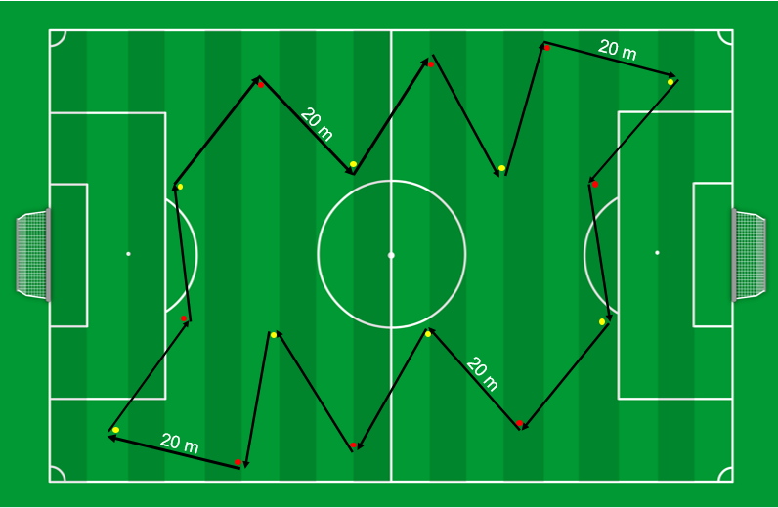
Thursday: High Intensity intermittent exercise
Referees
X
Set 1 (…) 6,17 min
Recovery 3 min
Set 2 (…) 6,04 min
Recovery 3 min
Set 3 (…) 4,47 min
Total duration ± 23 min
Walking W … m
Jogging J … m
Backwards BW … m
Sideways SW … m
High intensity HI 2120 m
Sprint S … m
Total distance 2120 m
Referees
3 sets of x reps
Referees: Dynamic Yo-Yo based: Yo-Yo Intermittent Recovery test Level 1
Set 1: level 13.1 – 15.8 (20 accelerations)
Set 2: level 16.1 – 18.4 (20 accelerations)
Set 3: level 16.1 – 17.8 (16 accelerations)
Recovery: 3 min in between sets
Notes:
LIMITS
Yo-Yo men: 18.2 // women: 16.4
DYY men: 18.8 // women: 17.8
Set 1: level 13.1 – 15.8 (20 accelerations) time 6,17 distance 760
Set 2: level 16.1 – 18.4 (20 accelerations) time 6,04 distance 760
Set 3: level 16.1 – 17.8 (16 accelerations) time 4,47 distance 600

Slide 72
Thursday: Strength exercises

Slide 73
Success!
Kader Touati: mobile 00 689 74 34 51 mail kad.touati@gmail.com
Jean-Baptist Bultynck: phone +32 16 375 780 mobile +32 486 54 72 19 mail jean-baptist.bultynck@ucll.be

